Slide 1
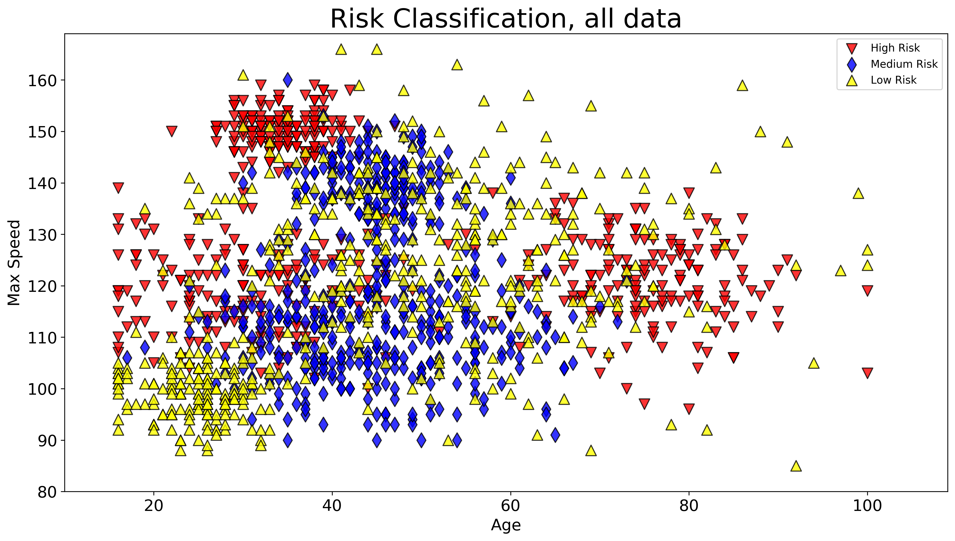
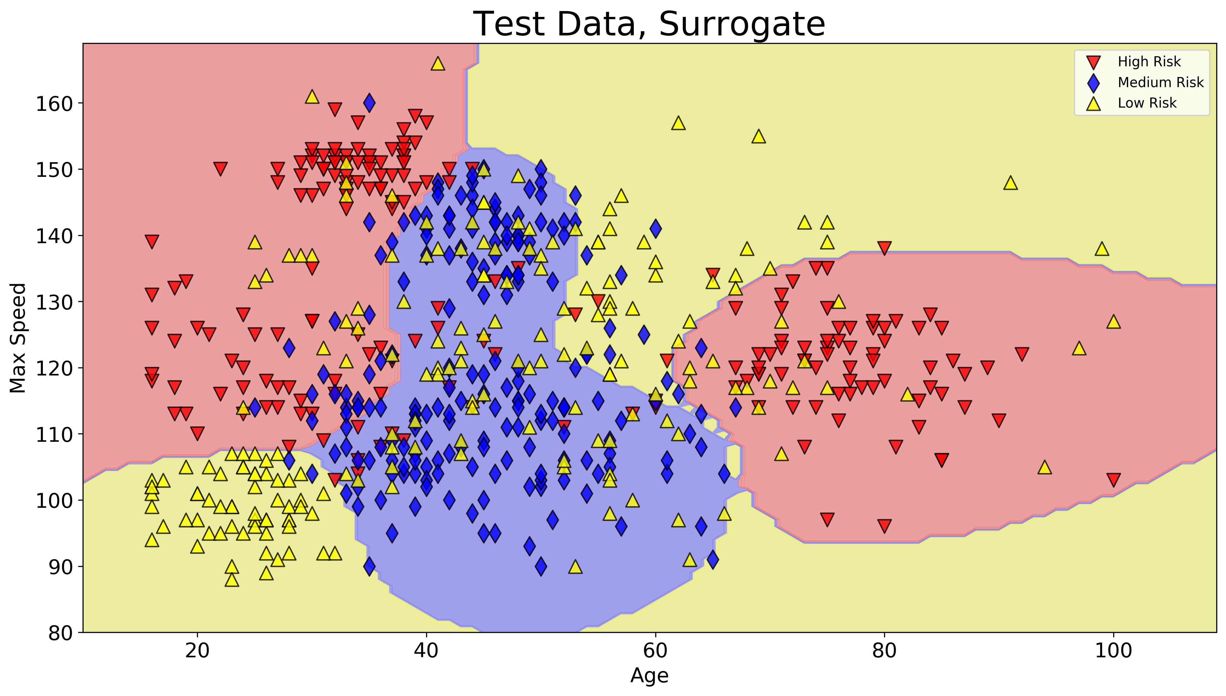
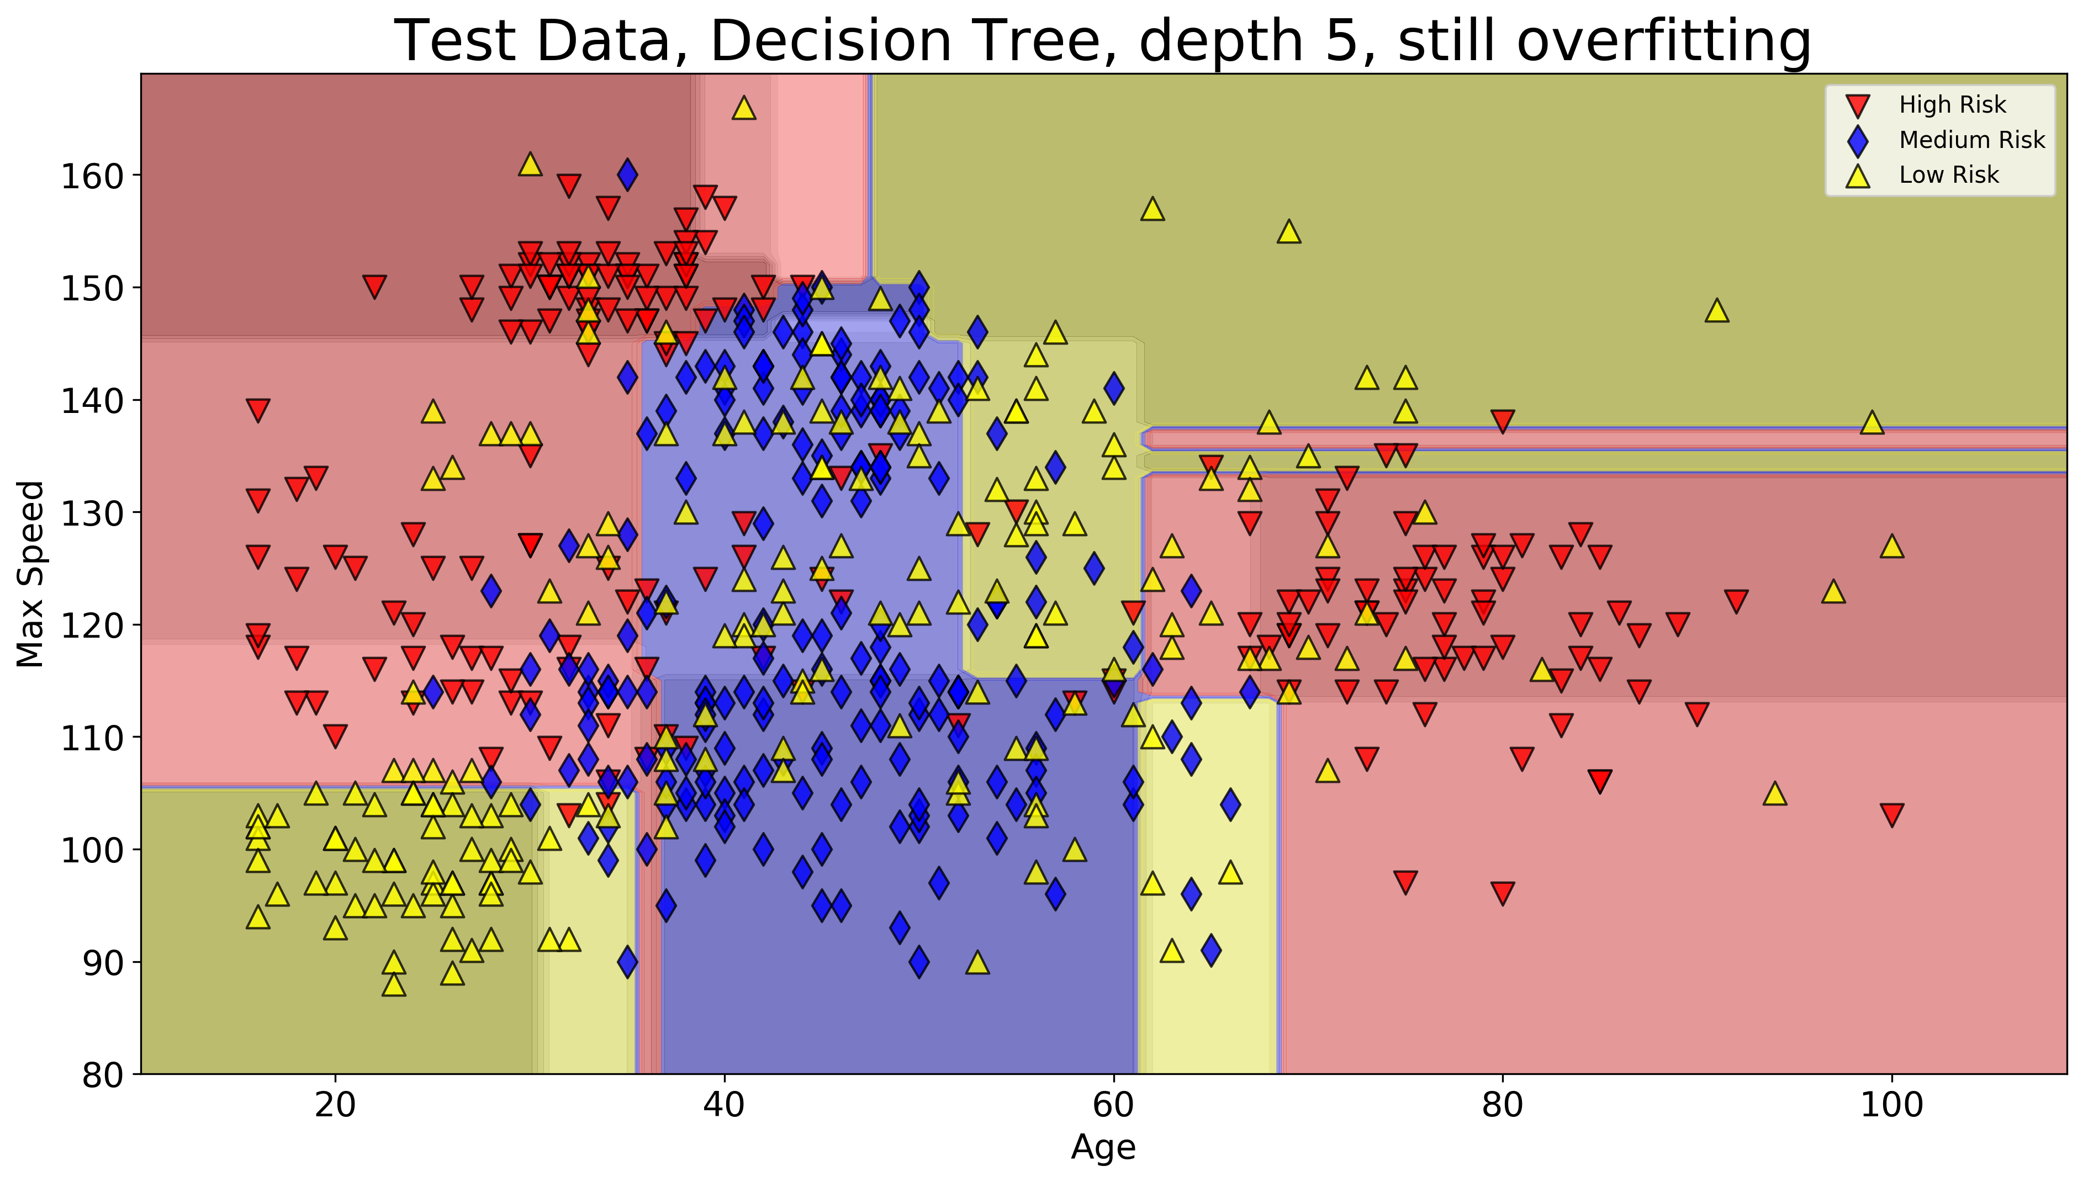
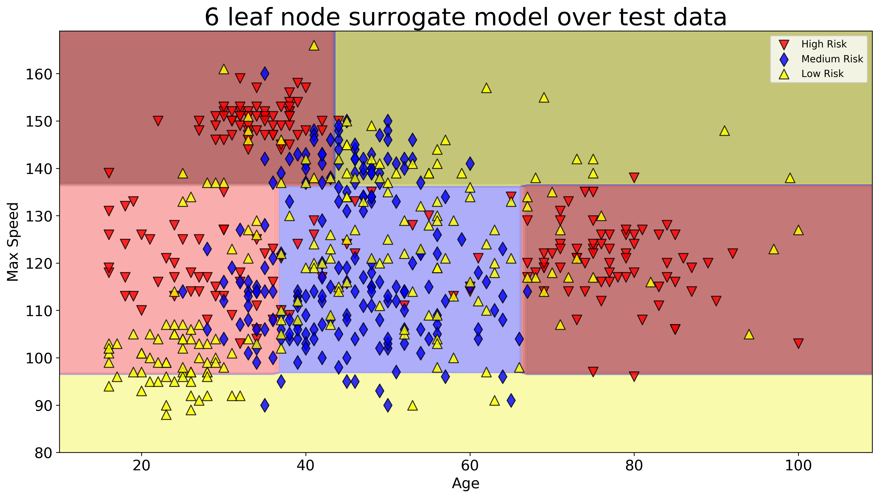
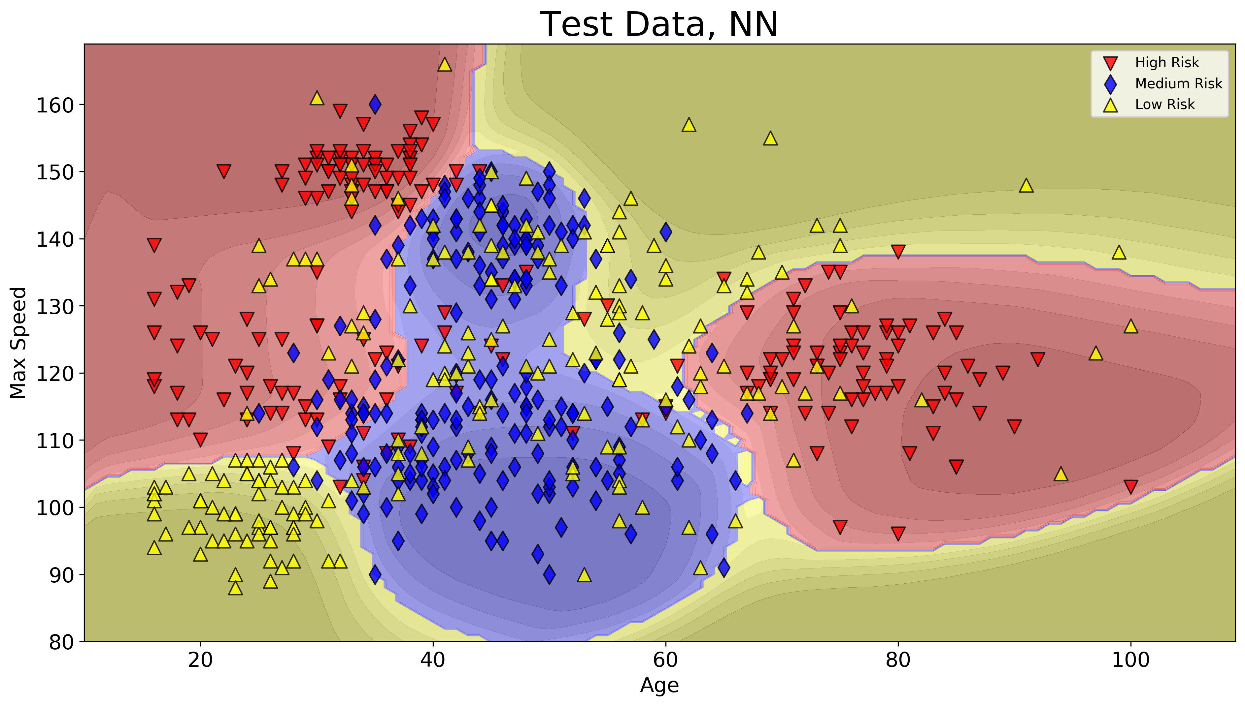
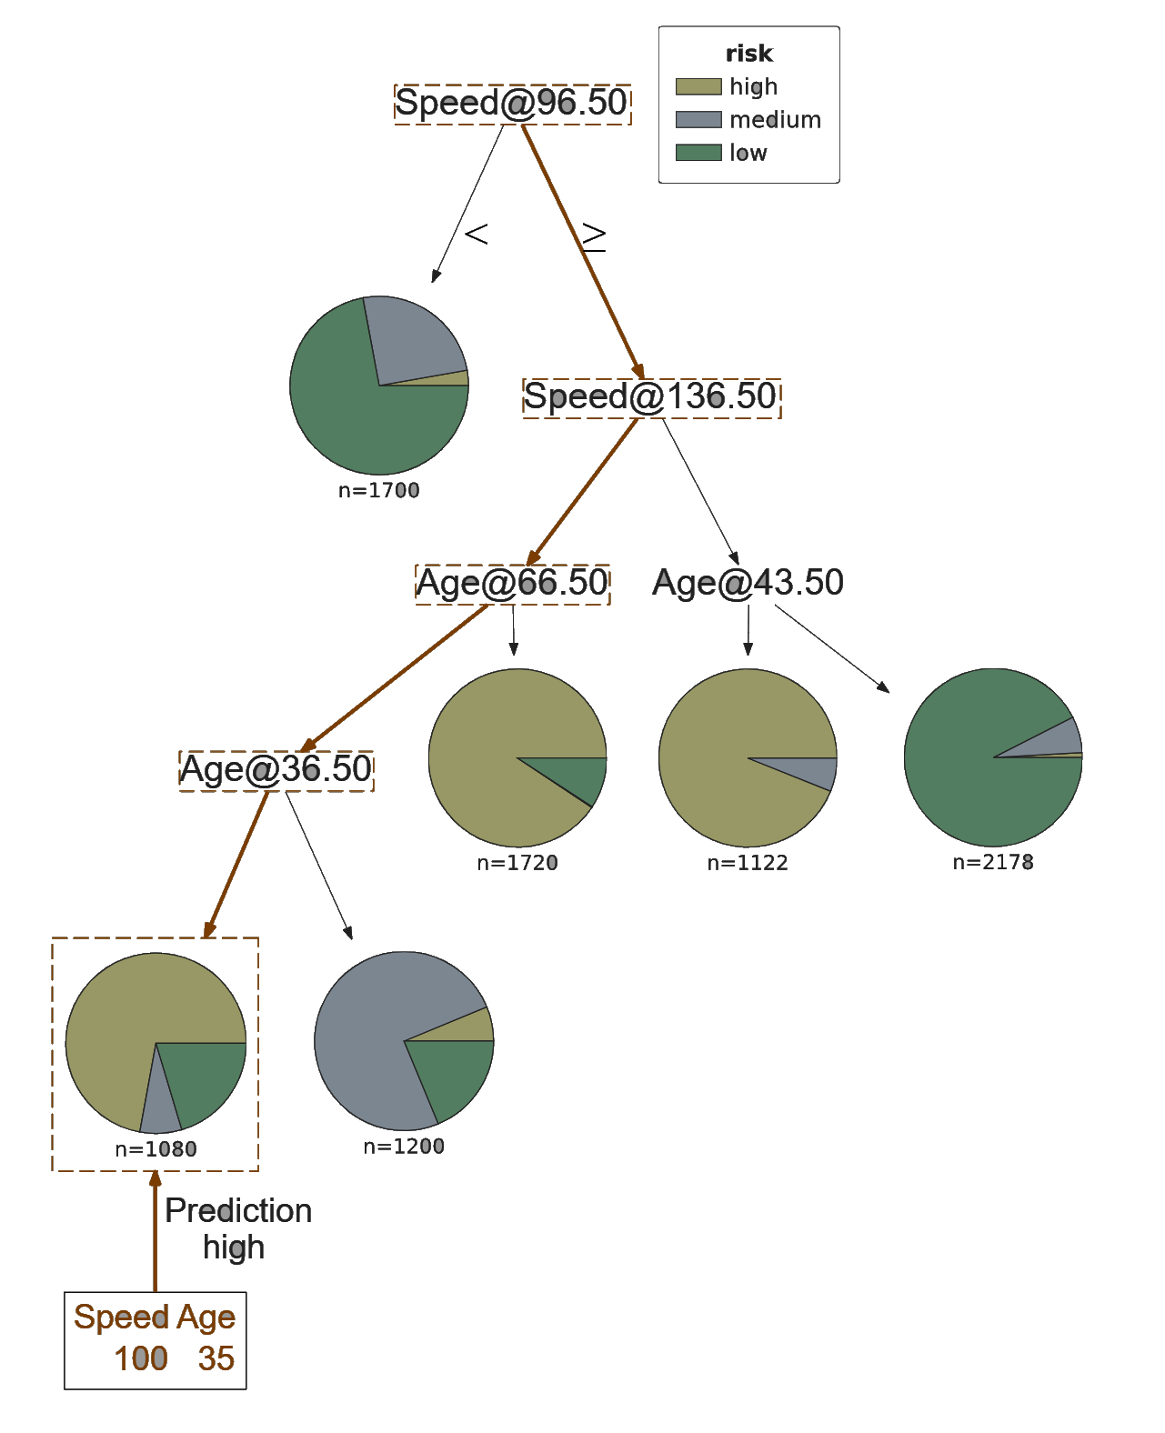
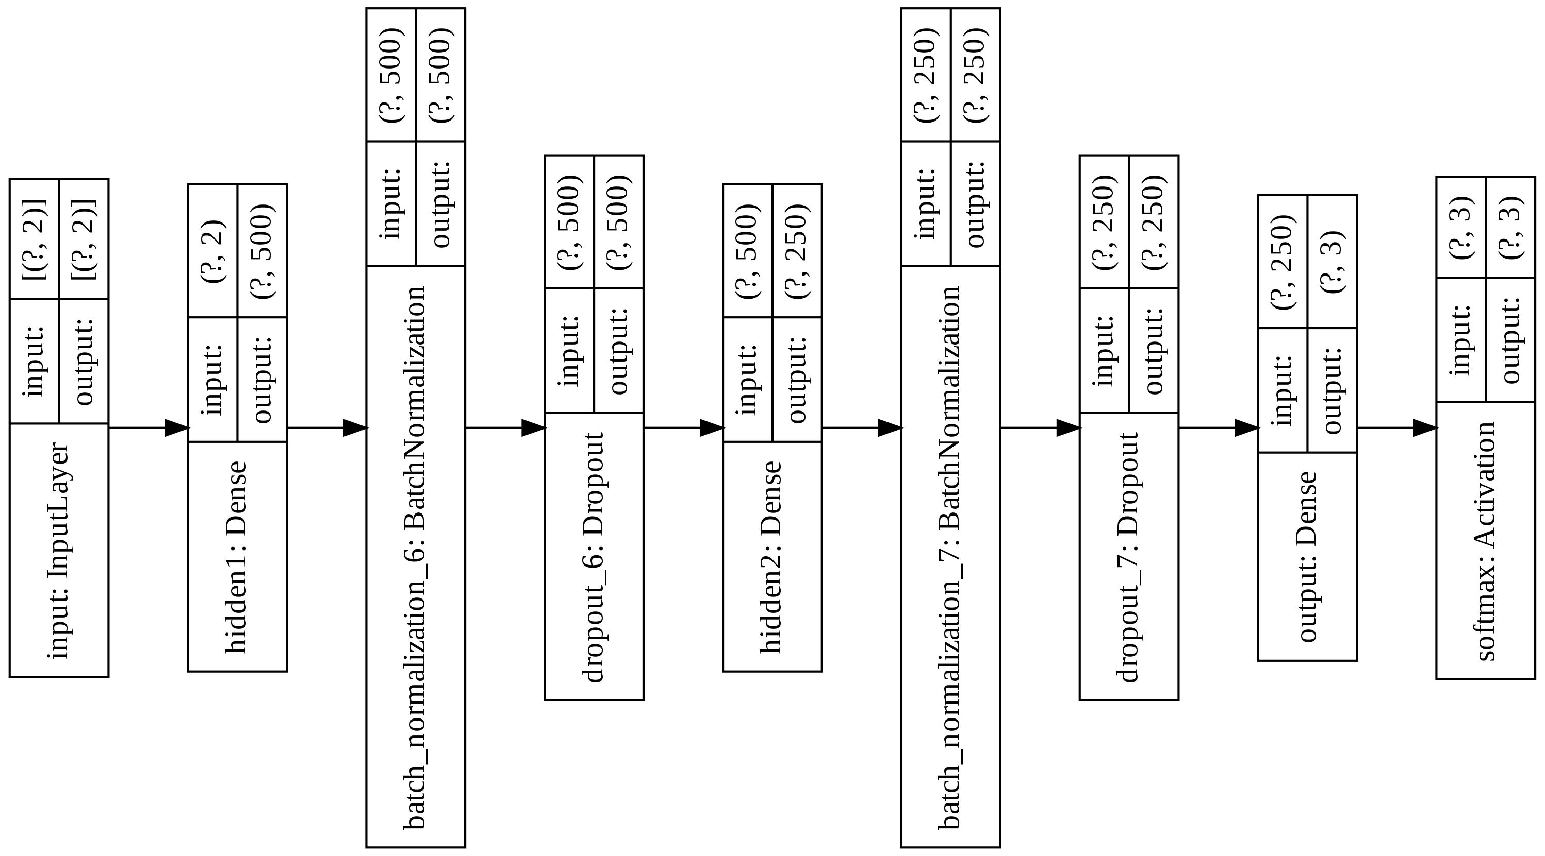
Scaling Down – Squaring Deep Neural Networks for interpretation and lightweight deployment Oliver Zeigermann, http://scaledml.org/2020/
Use Case - Risk Prediction
We want to score the risk of potential customers based on their age the max speed of their cars.
Deep Neural Networks can solve this
gives high accuracy without any overfitting, but also 130k parameters make this a block box
Student Decision Tree can be tuned for
accuracy: same score as teacher, but depth of 12
explainability: only six leaf nodes, and depth of 4
Sample prediction path
Decision Trees offer explainability
the right to explanation is well established by the GDPR and United States' Credit score
shallow decision trees allow for at least a basic level understanding,
but tend to overfit even when regularized
can be used to generate readable code from
cheap to bring into production
Best of both worlds – use DNN as a teacher for Decision Trees
high capacity deep neural network is trained and regularized like shown in left column
used to predict a dense set of data over complete range of domain
this data, not original data, is used to train decision tree
does not overfit
Notebook: http://bit.ly/scaling-down-2020

